Slide 1


Refactoring Legacy Code
@sugendran
Notes:
XMLHttpRequest == 15 years ago
Firefox vs MSIE == 4 years later, 11 years ago
Existing code works, and it’s why you’re employed

Slide 2


#sjsSugendran
Yammer Frontend is a busy place
24 Engineers across 3 offices
5 years of experimentation
Mix of open source and custom frameworks
Notes:
What is Yammer
How we use MVPs
Custom frameworks + Open Source == steep learning curve

Slide 3
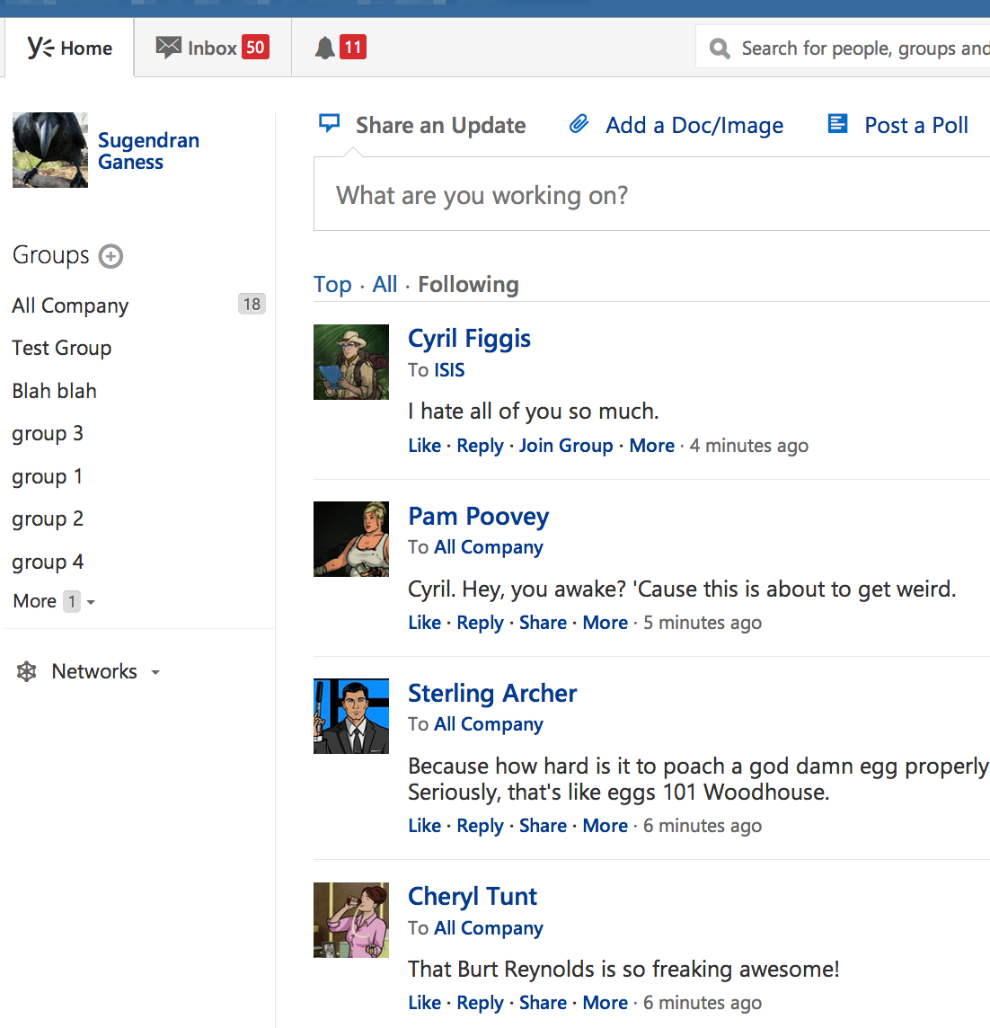
#sjsSugendran
The Thread List
Core component of Yammer
Lots of experimentation
Hard to understand
Notes:
What is the thread list
Had most of the experimentation
Slow to work in/understand
Async rendering is unpredictable

Slide 4
#sjsSugendran
Don’t hate past team mates
Past decisions were made
for good reason
Notes:
Don’t got hating past team mates
Their code means you’re employed

Slide 5
#sjsSugendran
Rewrite vs Refactor
Time to ship is the most important
Many years of changes and bug fixes
Consider the costs to other projects
Notes:
Tricky decision, different for everyone
Time to ship on a rewrite is more important than on a refactor
4 years of changes and bug fixes
Compliance cost

Slide 6
#sjsSugendran
Working alone is dangerous
No one works alone at Yammer
On our own we don’t have all the answers
A stubborn person will help keep you honest
Notes:
Myself and one other person
Don’t refactor in a silo
No one works alone
I don’t have all the answers
Have someone to bounce ideas off

Slide 7
#sjsSugendran
Understand the domain
Do you know all the use cases?
Not everything is written down
Limit the scope after the research
Notes:
Research needed to understand the domain
Talked to team about their problems
Spent a full week doing research
Limit the scope

Slide 8
#sjsSugendran
Keep the team in the loop
Get feedback before starting
Share the spec and answer questions
Everyone should understand the changes
Notes:
Important to have everyone accept the change
No resentment
Get feedback before starting
Share the spec
Be available to answer questions and help

Slide 9
#sjsSugendran
Release early, release often
Get into master as fast as possible
Use a feature gate
Allows the team to be aware of changes
Notes:
Step 1: Commit to master
Use a feature gate
What is a feature gate, no long branches
3 projects did work along side us
1 month till first merge to master and then every few days

Slide 10
#sjsSugendran
Fork the tests
Tests give you confidence
Spent the last year getting coverage up
You can’t refactor without tests
Notes:
Fork the tests
Both old and new should be under test
Over the last two years we’ve gotten to 70% coverage – 5781 tests
Tests give you trust

Slide 11
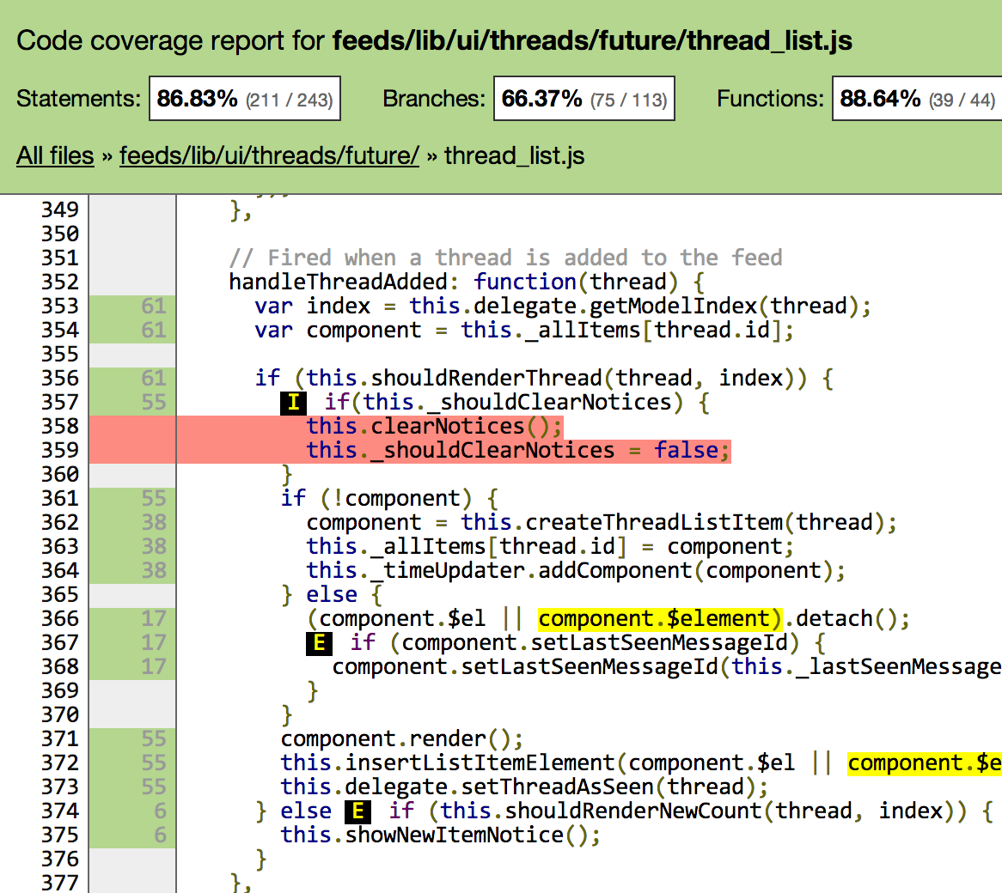
#sjsSugendran
Instanbul
http://gotwarlost.github.io/istanbul/
Notes:
Istanbul instruments your code
See what branches or paths are not taken
Iteratively improve coverage

Slide 12
#sjsSugendran
Think about the API
How will others use this component?
Hack up different approaches
Be explicit – don’t repeat past mistakes
Notes:
Stop and think about the API
Argued for two weeks
Hacked up approaches
Be explicit – don’t repeat past mistakes

Slide 13
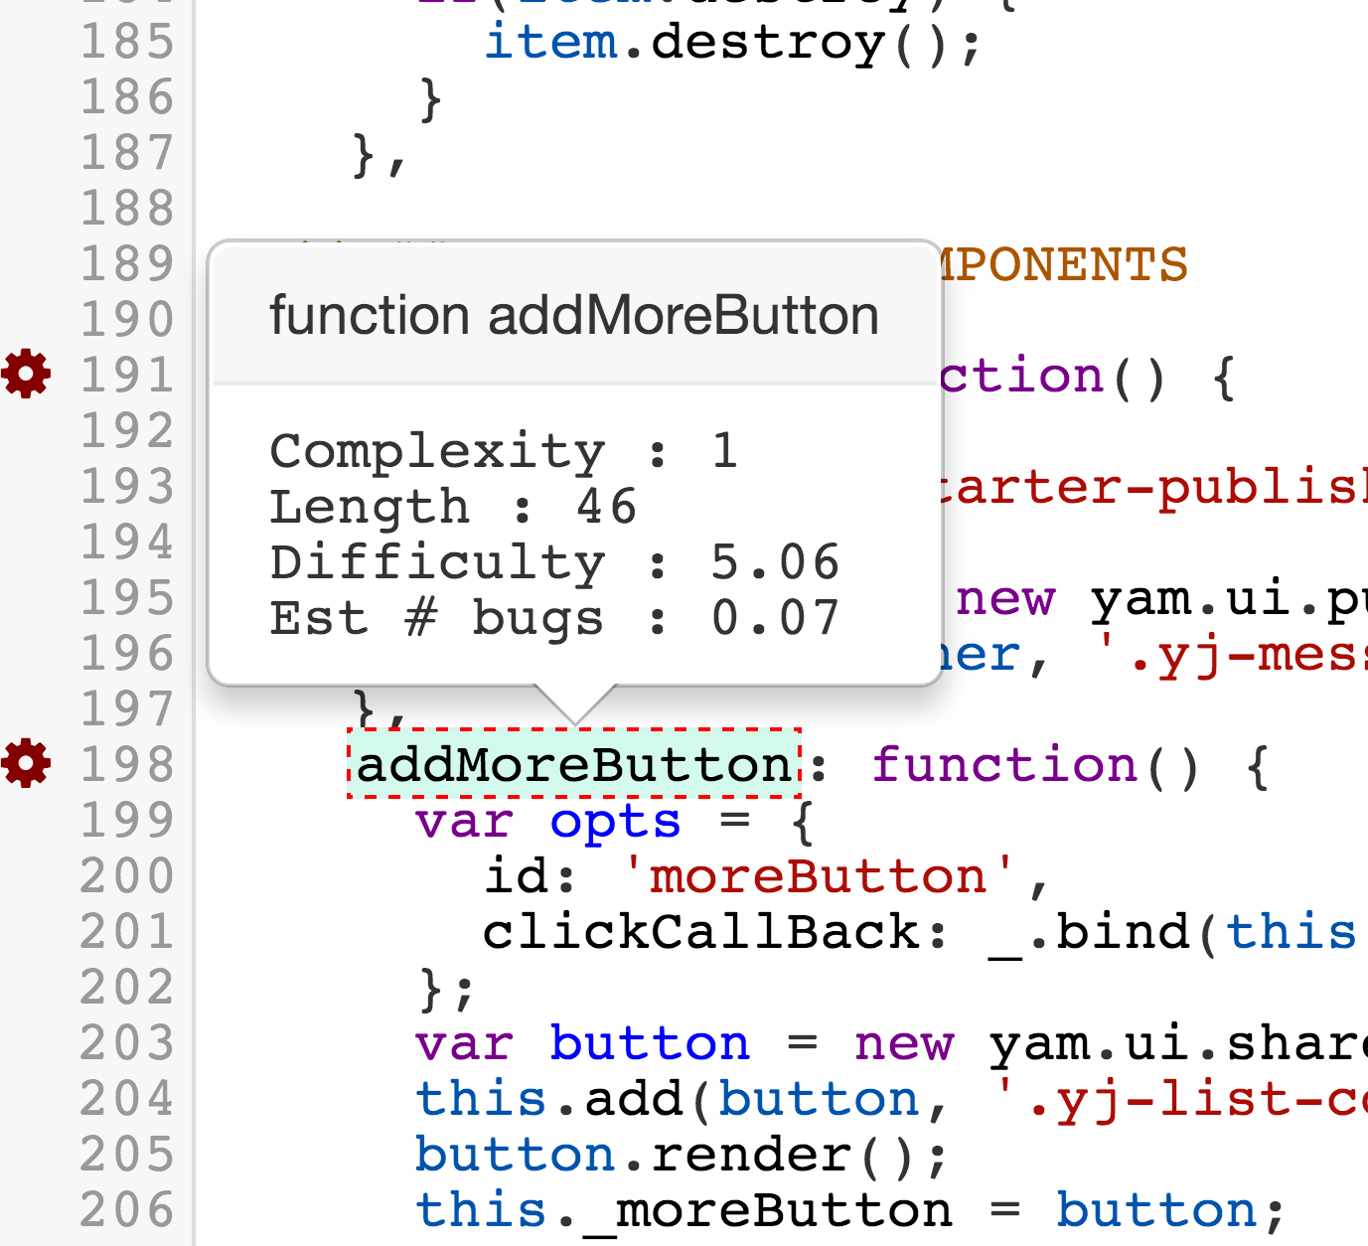
#sjsSugendran
Plato
http://platojs.org
Notes:
We used Plato to track complexity
Complexity measures the paths
Less paths means less unexpected behaviour

Slide 14
#sjsSugendran
When is the project finished?
Don’t let scope creep
There will be diminishing returns
Remove the feature gate
Notes:
When to stop?
Scope was set at start
Diminishing returns
Code is easier to understand
Removed feature gate

Slide 15
#sjsSugendran
Avoid the long tail of bugs
Release early and have the team find bugs
The AB test system lets us test on Microsoft
Found features we didn’t account for
Notes:
Feature gate === AB Test → open up to MSFT
Release early to test features we missed
Release early and have others find bugs

Slide 16
#sjsSugendran
Future Works?
Write down the things outside of scope
Will there be a phase 2 and 3?
Give other teams a head start
Notes:
Write down all the things outside of scope
Give other teams a head start

Slide 17
#sjsSugendran
Before and After
40% less code
Removed asynchronous rendering
Positive feedback from feed projects
Notes:
40% less code
Removed async rendering – explicit about how rendering works
Successful?
Feedback from new project doing work in the new threadlist is positive

Slide 18
#sjsSugendran
One more Thing
Released to all users
Notes:
50% of users had close to no change
Other 50% had faster and more predictable rendering
Refactor successful

Slide 19
#sjsSugendran
Questions?
See you in the discussion track
@sugendran

